Slide 1
Advanced Knowledge About Arduino
Dr. Xiaoming Li
(lxm@lxm.name)

Slide 2
Arduino Basics Review
Program Structure
setup() and loop()
Basic digital I/O, analog input and PWM output
digitalRead() / digitalWrite()
analogRead() / analogWrite()
Functions
String, date, time, calculation, etc.
Serial communication

Slide 3
Demo: Echo System (1)
Requirements
Given Arduino, Ultrasonic Module, measure the distance
Print the distance through the serial port
How to design?
Pick a software framework
Distribute the jobs
Change the jobs into codes

Slide 4
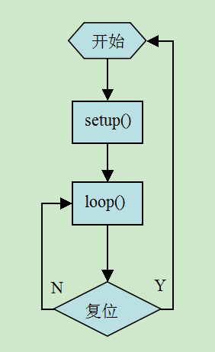
Demo: Echo System (2)
Describe the software functions logically
configure
setup pins state
setup serial port
send an ultra-sonic beep through the module
send trig signal through the pin
wait until recieve the bounced beep
watch the echo signal through the pin
measure the time elapsed
use pulseIn()
calculate the distance
send the result through serial port

Slide 5
What do we get from the demo system?
Learn how to write general arduino programs;
Get familiar with the functions provided by arduino;
Get familiar with the setup() and loop() framework;
But
Can you write codes for time-critical system?
Can you write codes that do more than one things at the same time?

Slide 6
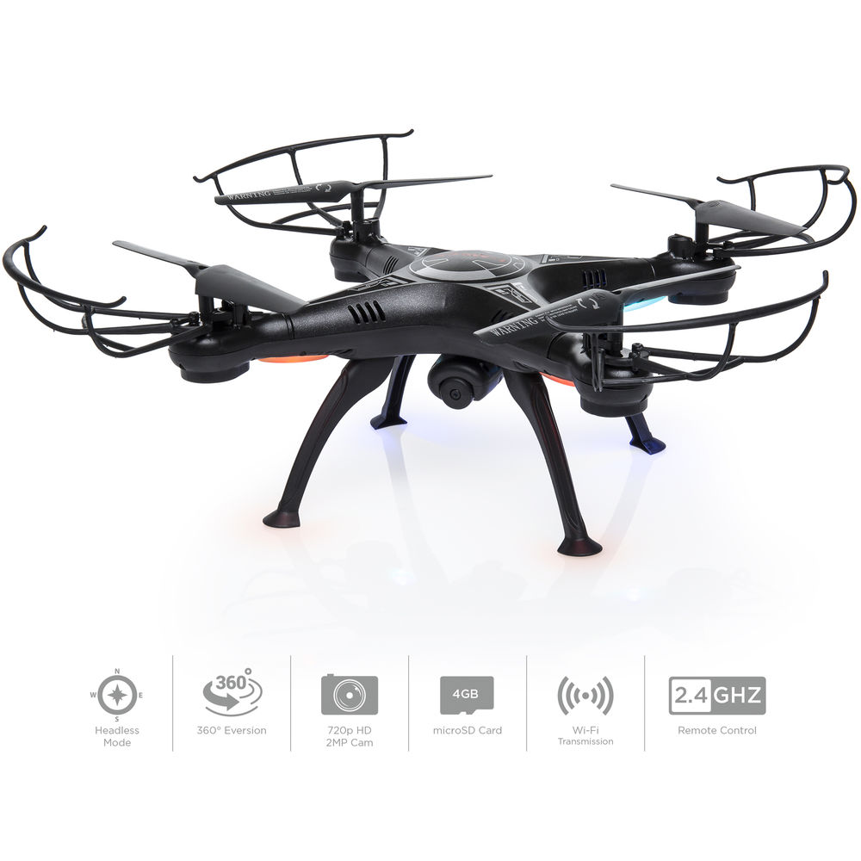
Real-time Control
Real-time control requires acurate control period
Sample rate determines the control period
T is a constant value in any algorithms in discrete control system
Unstable T leads to the unstable state of the whole system
Cannot use delay() in super loop
Only hardware timer can provide accurate time intervals

Slide 7

Multi-tasking
How to do multiple tasks in an easy way?
Time sharing method

Slide 8
Advanced topics
About Timer
How to use the arduino library
How to write your own library
Timer based multi-tasking

Slide 9
AT1: Timer
What is timer?
Timer is a reminder that is strictly remind your code to do somthing at specified time instante.
Why Timer?
Timer is very important in Real-time system.
Generate a very presice time delay.
Timer can work in backgroud / not comsuming CPU resources.

Slide 10
AT1: Timer
Hardware Timer V.S. Software Timer
Hardware timer usually available in CMU based system.
Software timer usually available in PC based system.
In Arduino, we use hardware Timer.
Hardware Timer
2 timers in Arduino
need to set the initial value, enable the interrupt
do something in the interrupt service function

Slide 11
Timer in Arduino
Hacker's way
need knowlege about AVR MCU and C++
hack into aruidno's codes to use C++ directly
may NOT portable!
Smart-guy's way
do it using library
or
do it using millis()

Slide 12
AT2: Arduino Library
What is Arduino Library for?
Provide extendable functions in addition to the basic library.
A way to write BIG programs.
Code re-use.
Where can I find the Arduino library?
How to use the library in my project?

Slide 13
AT2: Arduino Library
What is Arduino Library for?
Where can I find the Arduino library?
IDE
Download from developers' website
Write you own.
How to use the library in my project?
Use IDE to include the library.

Slide 14
AT3：How to write library
Using Class to encapsulate the source code
Essentially the library is a C++ class or package.
Put it into the library directory.

Slide 15
Example: MsTimer2
/*
MsTimer2 is a small and very easy to use library to interface
Timer2 with humans. It's called MsTimer2 because it
"hardcodes" a resolution of 1 millisecond on timer2 For Details
see: http://www.arduino.cc/playground/Main/MsTimer2
*/
#include <MsTimer2.h>
// Switch on LED on and off each half second
#if ARDUINO >= 100
const int led_pin = LED_BUILTIN;// 1.0 built in LED pin var
#else
const int led_pin = 13; // default to pin 13
#endif
void flash()
{
static boolean output = HIGH;
digitalWrite(led_pin, output);
output = !output;
}
void setup()
{
pinMode(led_pin, OUTPUT);
MsTimer2::set(500, flash); // 500ms period
MsTimer2::start();
}
void loop()
{
}

Slide 16
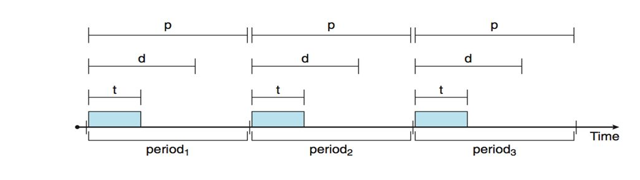
Timer based task scheduler

Slide 17
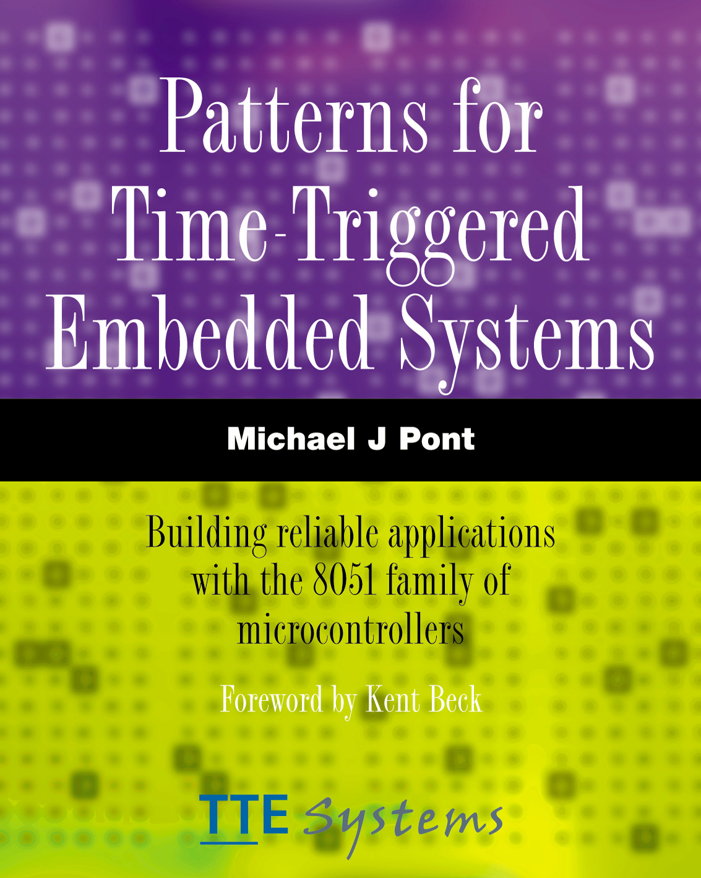
Homework
Michael J. Pont Patterns for time-triggered embedded systems,
Part C (chapter 13-17)
Learn to write simple task scheduler in Arduino Environment

